Slide 1
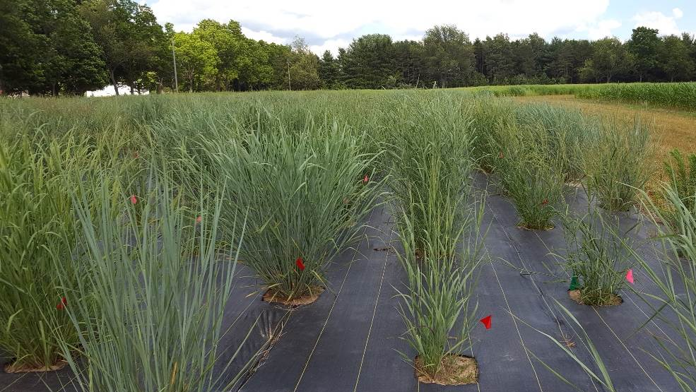
Genetics of Genotype-By-Environment Interactions in the Switchgrass Diversity Panel
Alice MacQueen
BER Plant Genomic Science Workshop
2020-01-13

Slide 2
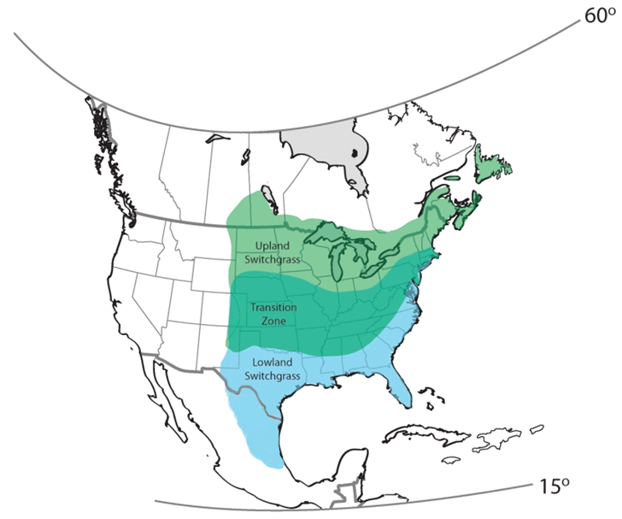
Switchgrass is the model herbaceous bioenergy crop.
Native to North America
Widespread distribution and wide environmental adaptation
Productive on marginal lands
High yielding (7-10 tons dry matter per acre)
If grown on ~5% of land in a 25 mile area, could supply a bioenergy plant 24/7/365
~8 USDA Cold Hardiness Zones
~60 inch variation in Annual Precipitation
Notes:
The DOE chose switchgrass as its model herbaceous bioenergy crop back in 1992, and it chose it for multiple reasons. First, switchgrass is native to North America, and is found across a wide range of environments and climates – across eight USDA hardiness zones, and across a 60 inch gradient in annual precipitation. Switchgrass can produce useful biomass yields, even on marginal lands, and it is also high yielding – yields of 7 to 10 tons of dry matter per acre have been reported for some switchgrass cultivars. To put those numbers in some context, plants yielding that well grown on about 5% of the land in a 25 mile area could supply a bioenergy fuel plant constantly for a year. And, come to that, if we had such a bioenergy plant for each switchgrass genotype in the diversity panel, we could more than double the current biofuel production of the United States. But any goal like that would require finding high yielding varieties that either perform well across many environments, or several varieties that perform the best in specific environments.

Slide 3
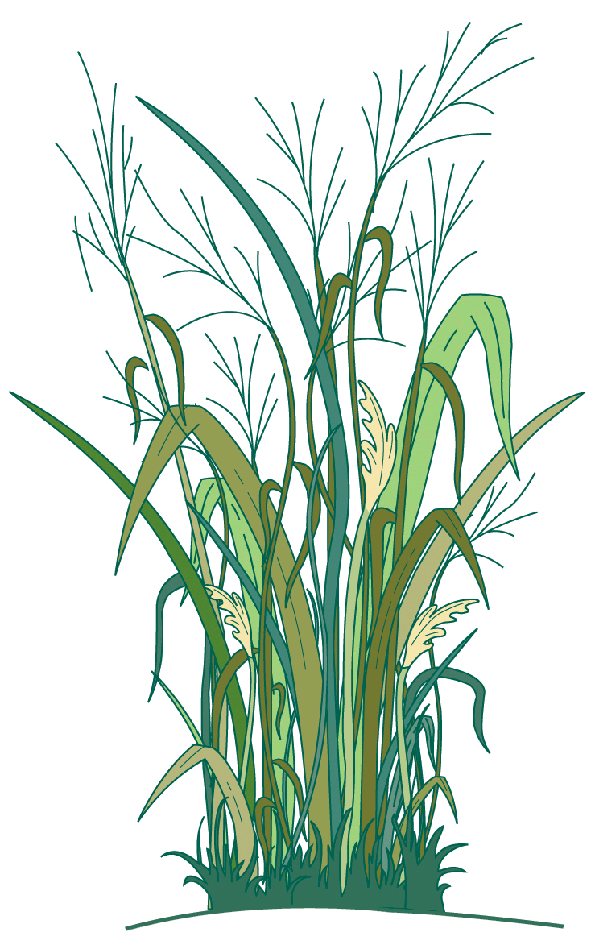
Switchgrass is the model herbaceous bioenergy crop.
Is switchgrass locally adapted to climatic gradients? If so, at what spatial scales?
What are the mechanisms, traits, and genes important for current or future adaptation to climate?
How important are genetic tradeoffs in driving patterns of climate adaptation?
Notes:
So many plant scientists have been very interested in understanding how switchgrass is adapted to its local environments. Some important questions they have been considering include: what are the spatial scales at which switchgrass is locally adapted to its environment? What are the mechanisms and genes important for switchgrass’s adaptation to climate? And how important are genetic tradeoffs, a particular type of genotype by environment interaction, in driving patterns of climate adaptation in this species?

Slide 4
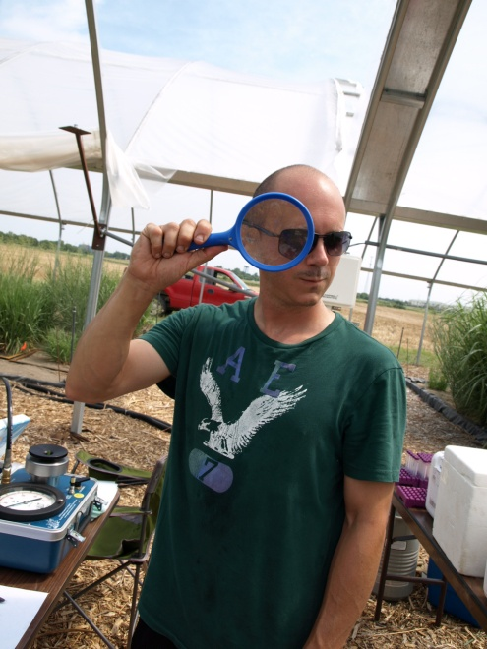









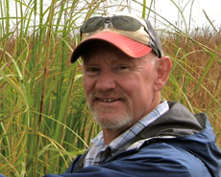
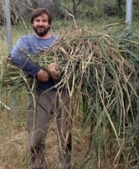
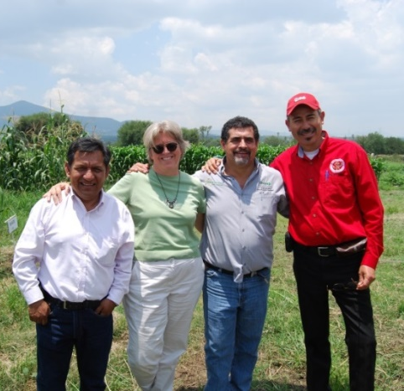


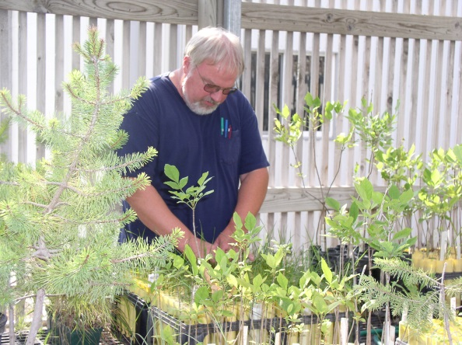


Notes:
mention Tom, Jeremy, Jane, and say it’s funded by the DOE sustainability program
5 years of work by dozens of researchers
Here are some of the scientists who have taken part in a collaboration to answer these questions over the past five years. Several of them are here in the audience today – in particular, three I want to mention are Tom Juenger, at UT Austin, who has been the lead PI on this grant, as well as Jeremy Schmutz and Jane Grimwood, at HudsonAlpha, who have conducted and driven forward the genome sequencing and resequencing for this work.

Slide 5
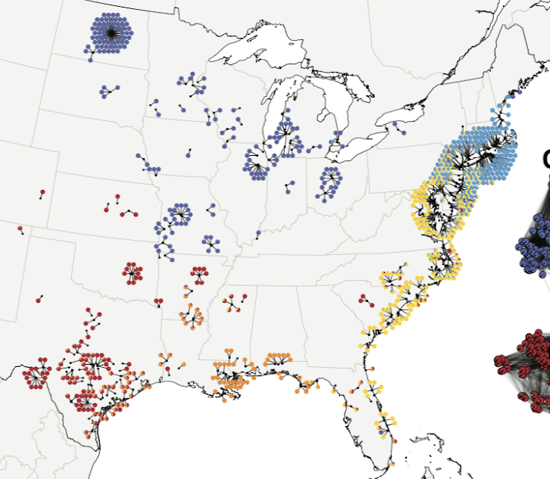
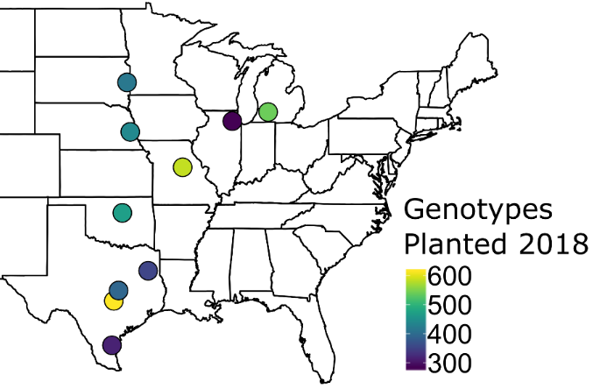
The switchgrass diversity panel was planted in ten common gardens to study adaptation:
Diversity Panel
~700 plants, ~40 million SNPs @ ~45x coverage
Common Gardens
10 U.S. Sites, 17° latitude
Collaborative and community building effort – including involvement of DOE JGI, DOE Bioenergy Centers, CIMMYT, Ladybird Johnson Wildflower Center and many others…..
Notes:
mention Sujan, John on SNPs
To study climate adaptation in switchgrass, we built a switchgrass diversity panel and planted it at ten common garden sites across the United States. The diversity panel was collected from the locations shown on the map on the left. Over 700 individuals were collected and resequenced through JGI and HudsonAlpha – particularly though the efforts of Sujan Mamidi and John Lovell, who has been leading the genome paper effort. These 700 individuals were resequenced to a median of 45x coverage, and we have over 40 million SNPs available for analysis in this diversity panel.
These 700 individuals were then clonally propagated so genetically identical individuals could be planted at these 10 common garden sites. These sites span 17 degrees of latitude, from Kingsville, Texas up to Brookings, South Dakota. The map on the right here is showing you the common garden locations, and the number of switchgrass genotypes that were planted at each site in 2018 – anywhere from 300 to over 600.

Slide 6
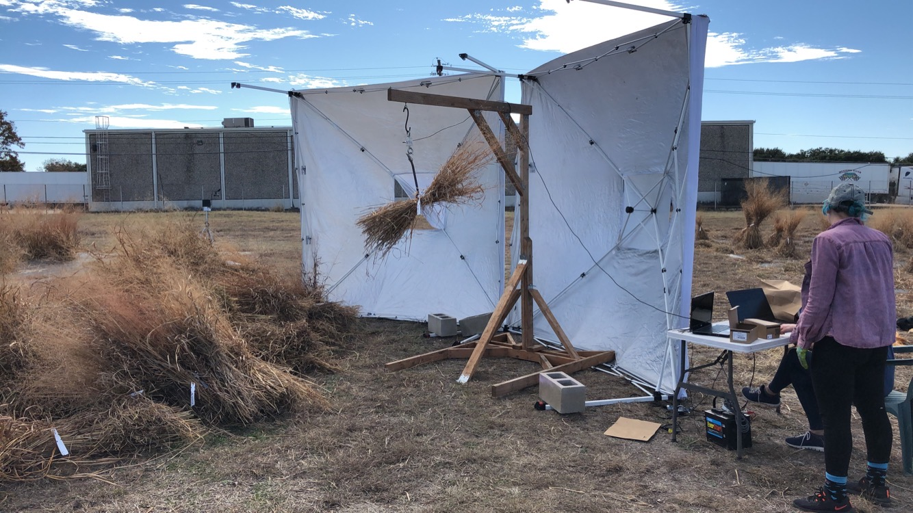
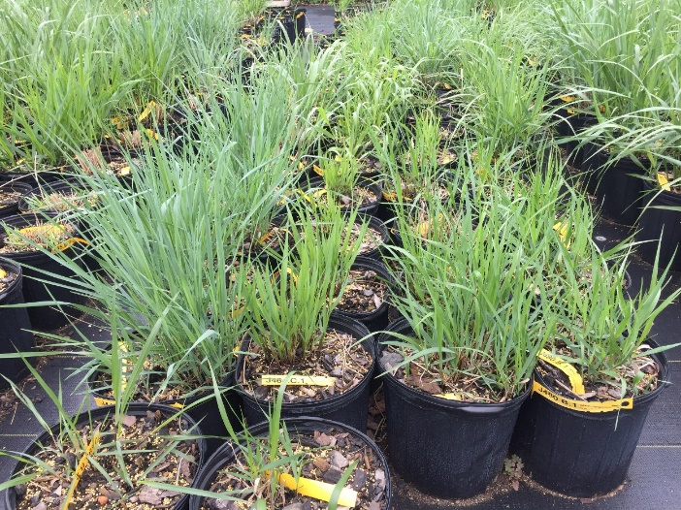
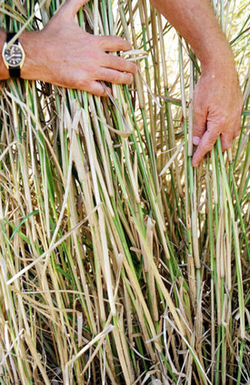
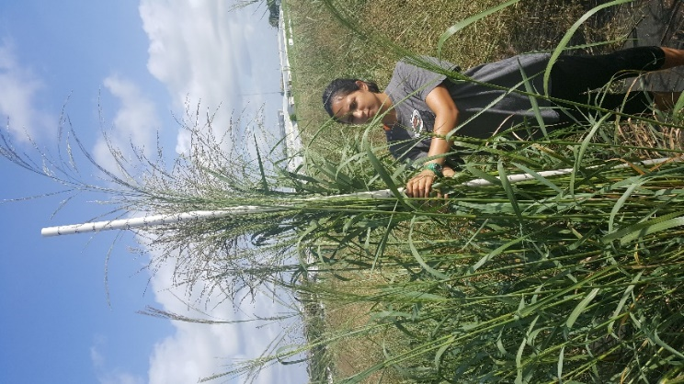
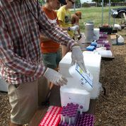
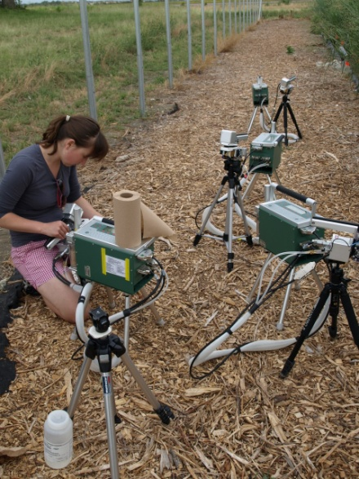

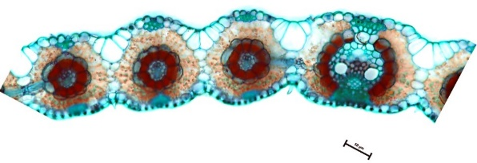
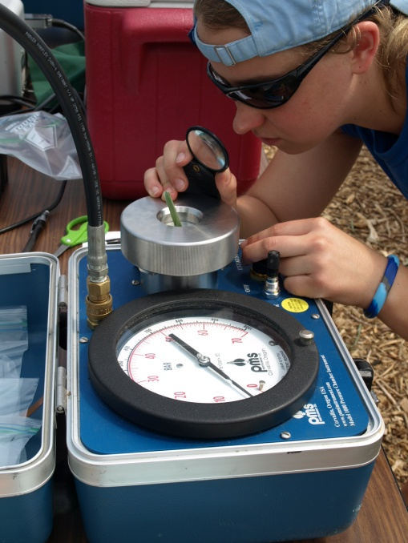
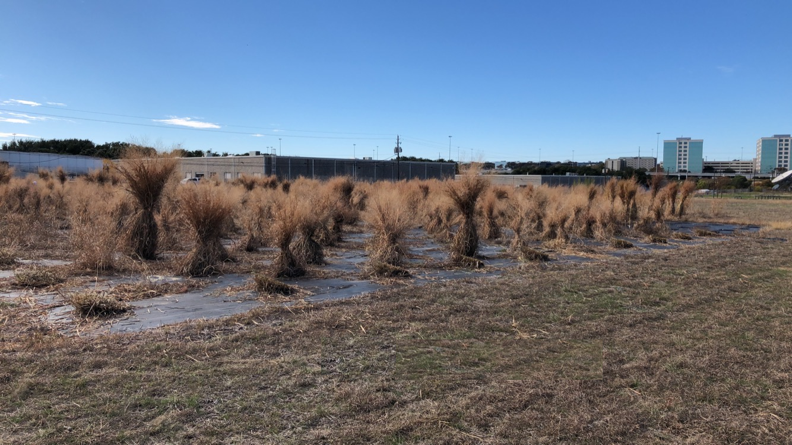
Notes:
In 2019, we then phenotyped plants in this panel like crazy – so here’s examples of our clonal propagation methods, and the weather station setup at the common garden sites. Jason Bonette managed much of the major phenotyping push. Traits we measured included tiller count – here’s some manual tiller counting – plant height and biomass, but a number of other campaigns were also carried out – both soil and tissue sampling, physiology, and anatomy, and high throughput phenotyping by drone.

Slide 7
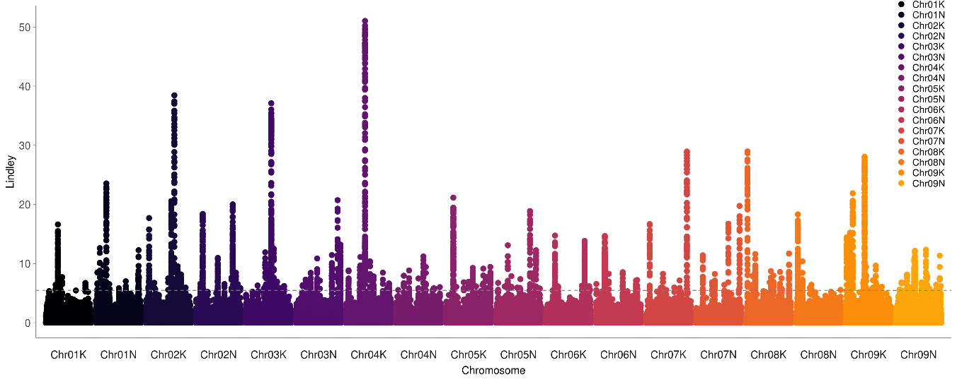
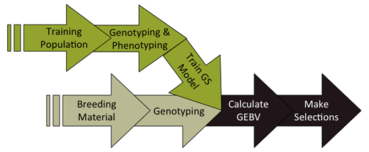
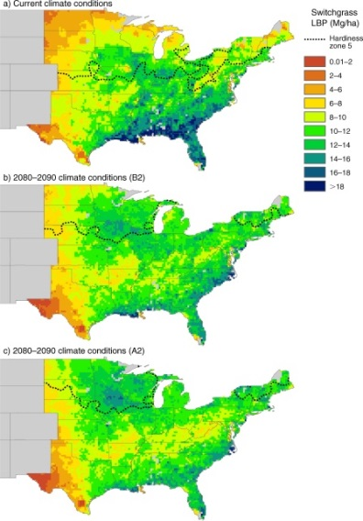
Association & Population Genomic Studies
Genomic Selection & Breeding
Climate Niche Characterization
Agronomic modeling
Notes:
With this data, we’ve begun a number of downstream analyses to look at the genetics of adaptation – association and population genomic studies, which I will talk about more today, but also genomic selection and breeding approaches, climate niche characterization for individual genotypes, and agronomic modeling of plant performance in current and future climate scenarios.

Slide 8
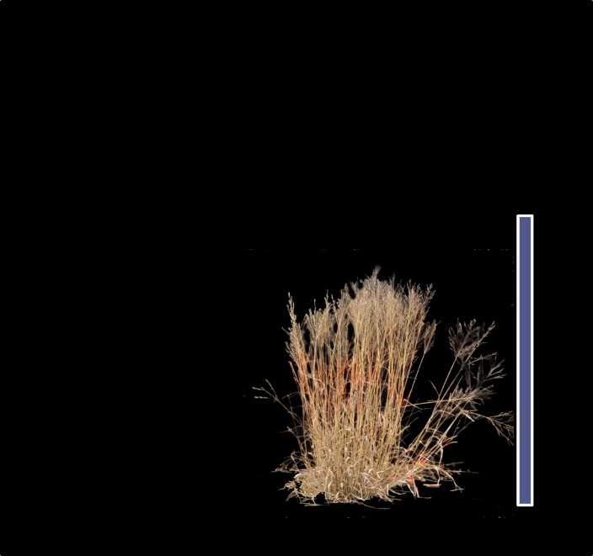
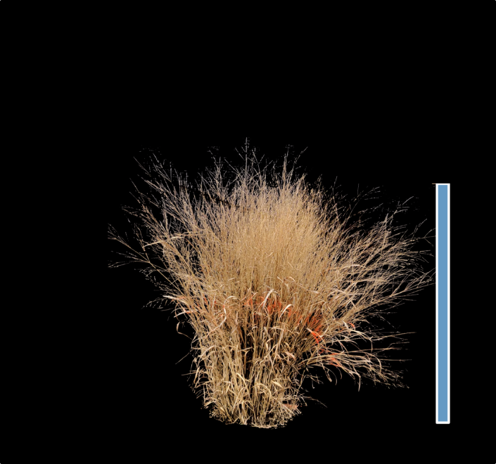
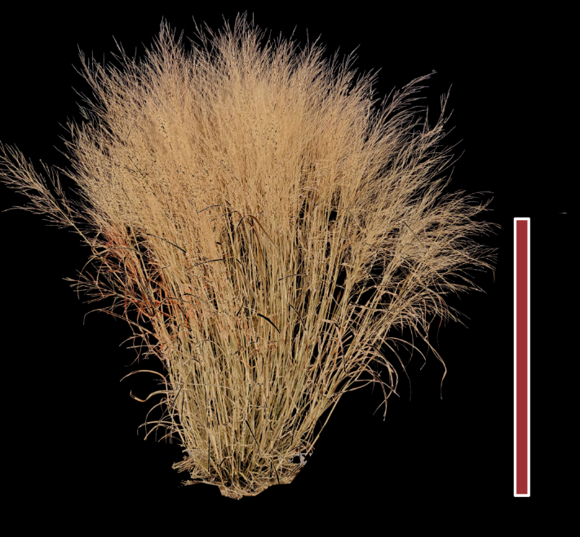
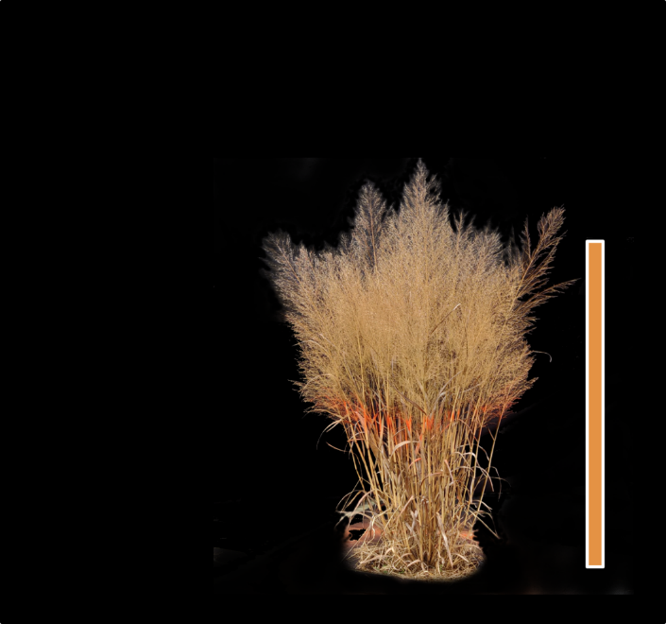
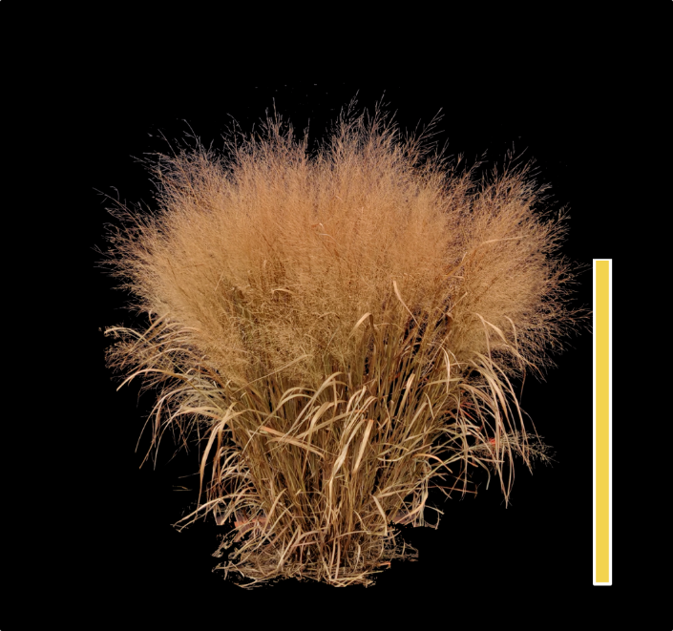
Diversity panel population structure and demography
Northern Upland
Northern Upland
Texas Lowland
Coastal Lowland
Coastal Lowland
(Lovell et al., in prep)
Notes:
Before I tell you more about the genetic association work, I want to familiarize you just a little more about the population structure and demography present in the switchgrass diversity panel. Our United States collected, tetraploid switchgrass falls into five genetic subpopulations and three ecotypes. The genetic subpopulations are shown by the colors on this map, and also by the colored scale bars on the right of each picture here. There are also three ecotypes present. Two of the genetic subpopulations are northern upland ecotypes, one is a Texas lowland ecotype, and two are Coastal Lowland ecotypes. Some of the results will be colored using this color key, and the only important thing to remember here is that northern material will have cool colors, and southern material will have warm colors. Make sense?

Slide 9
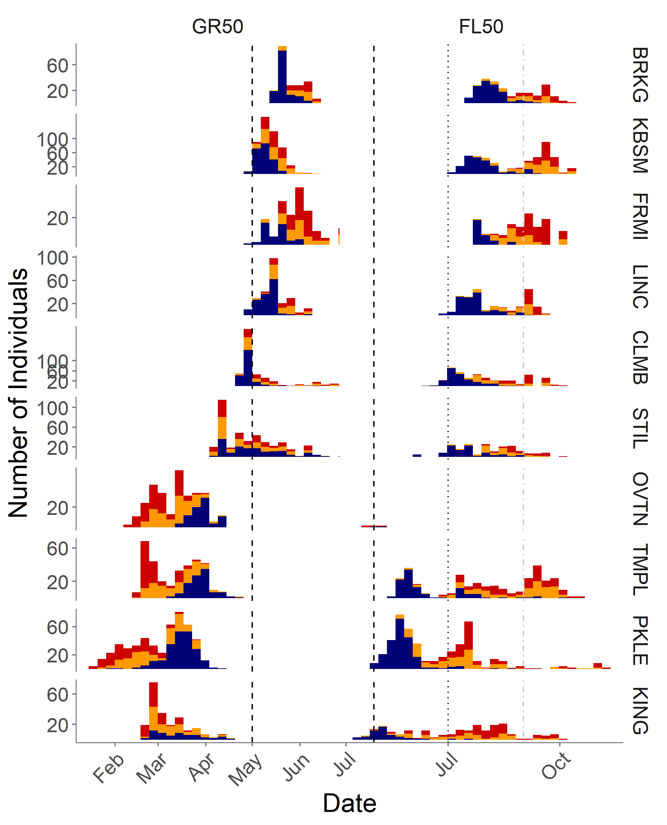
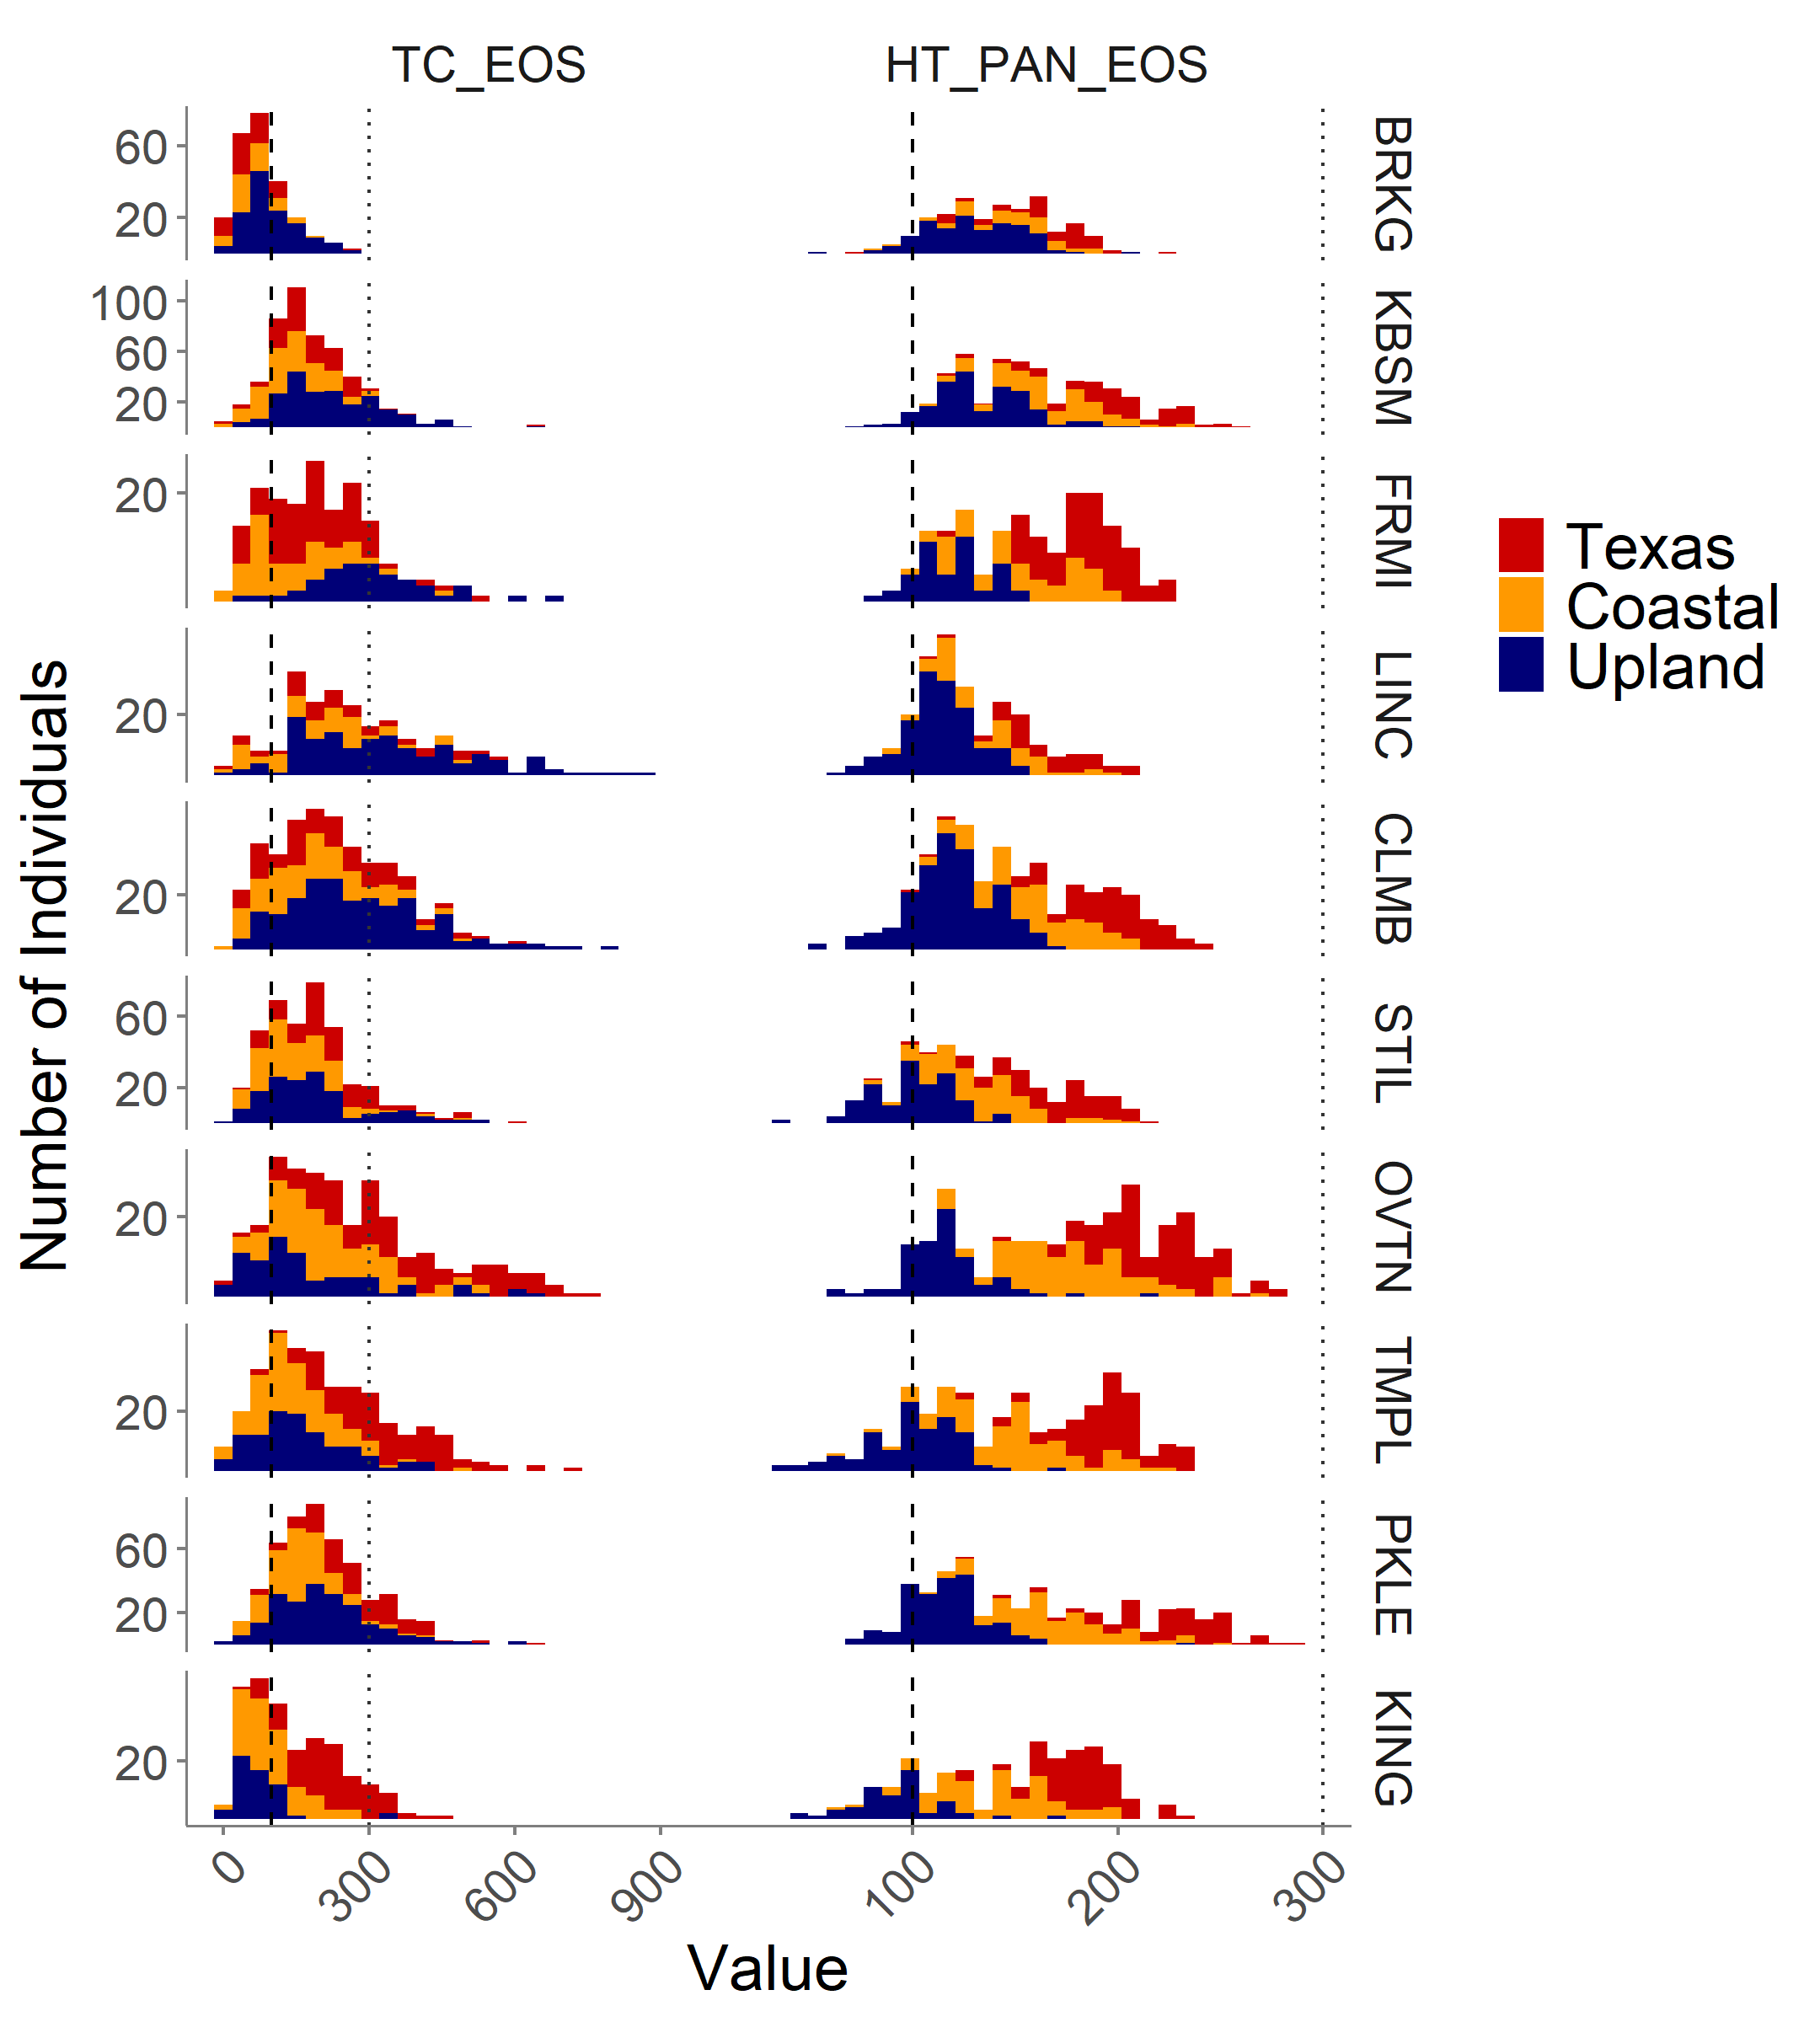
The first of the 2019 diversity panel phenotypic data:
Greenup
Flowering
Tiller Count
Height
Latitude
Notes:
Alright! Well, on Christmas day, I received the first of the 2019 diversity panel phenotypic data. Here are four of the phenotypes we collected at all ten sites. Each of the columns of histograms is a separate phenotype, and each of the rows of histograms is from a single common garden site. The sites are arranged in latitudinal order, so South Dakota is at the top here, and Kingsville, Texas is at the bottom. And, finally, the histograms are colored by plant ecotype. And all I really want to you to take away from this slide is that there is a large amount of phenotypic data, and that this data certainly differs by common garden location and by plant ecotype.

Slide 10
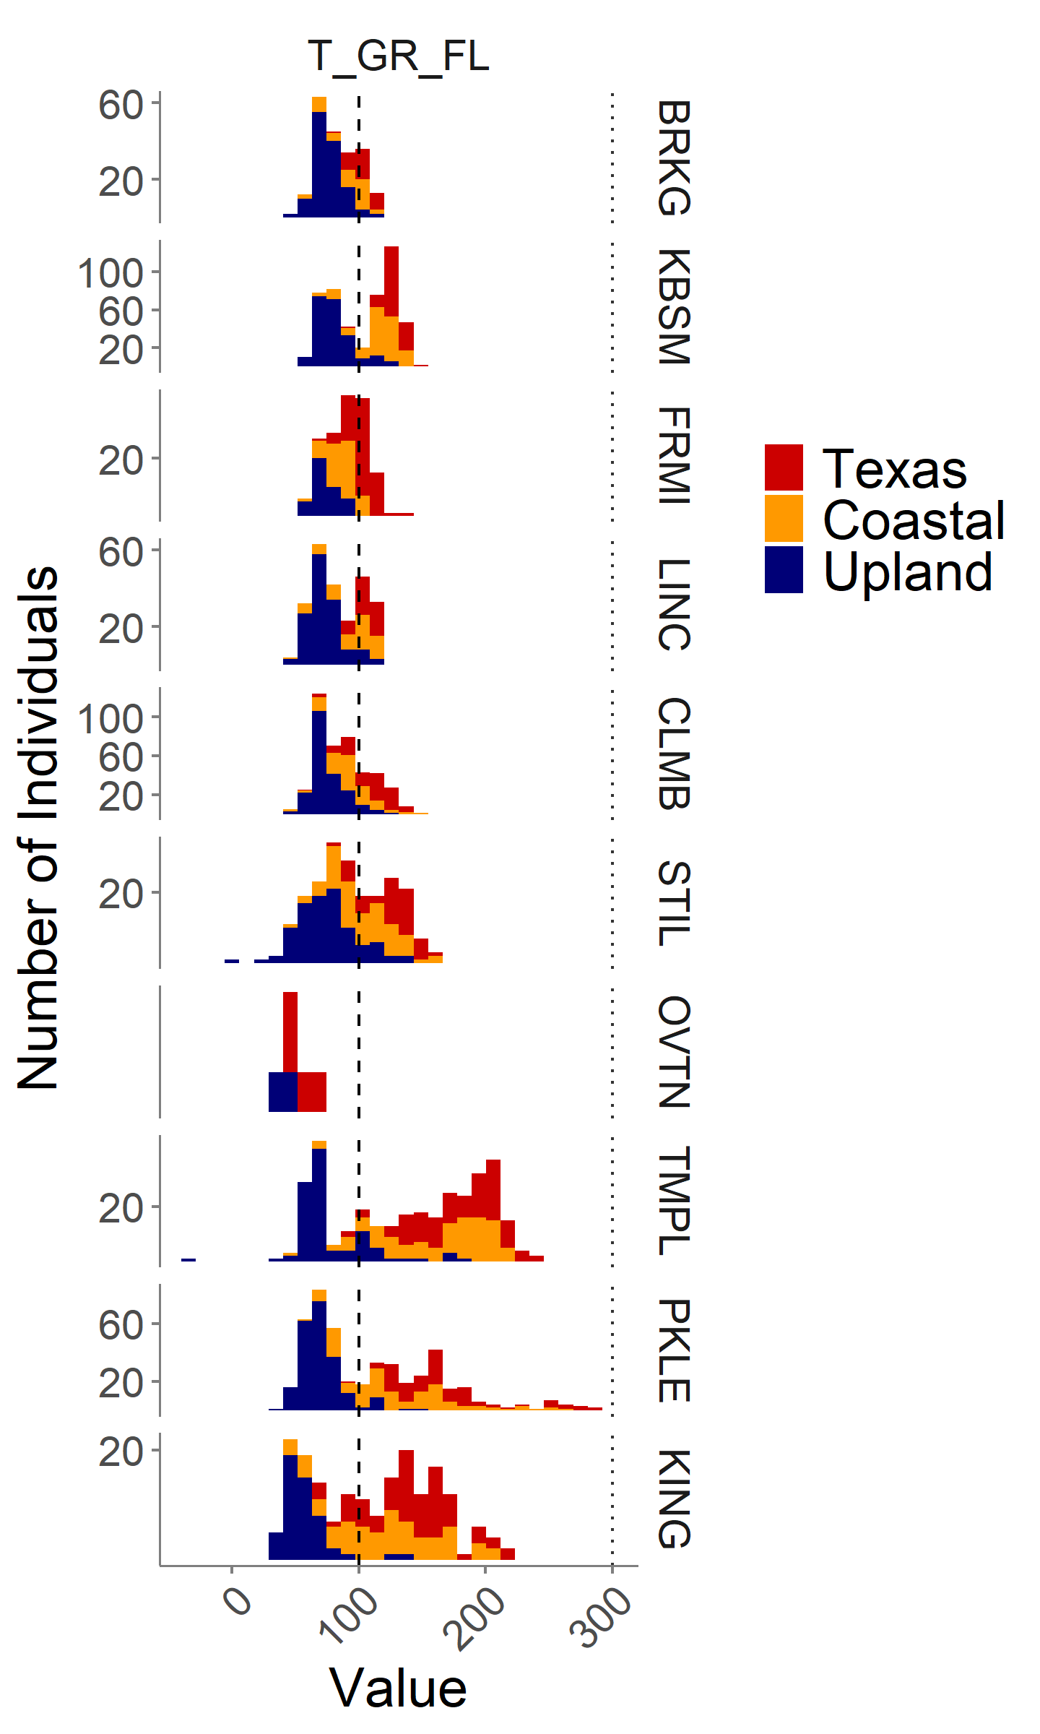
GxE in phenology is visible across the common gardens.
Greenup
Flowering
Days between Greenup and Flowering
Latitude
Notes:
This will be another simplified figure with better axis label sizes
We also certainly see evidence for GxE in phenology traits across the common gardens. Here, the first two columns are the same as the previous slide – greenup date and flowering date. And the third column is the number of days between greenup and flowering. And you can maybe see that while the upland individuals have a consistent number of days between greenup and flowering across sites, the Texas and Coastal lowland individuals have a spread in this value that depends on the location that they are planted at.

Slide 11
GxE in phenology is visible across the common gardens.
Greenup
Flowering
Days between Greenup and Flowering
Northern germplasm grown in the south has photoperiod sensitivity, leading to early flowering and low biomass.
Southern germplasm grown in the north does not have freezing tolerance and does not survive winter.
Latitude
Notes:
This fits into a known paradigm for genotype by environment interaction for switchgrass. This paradigm holds that northern germplasm grown in the south has photoperiod sensitivity, which leads to early flowering and low biomass. In contrast, the southern germplasm grown in the north does not have freezing tolerance, and thus does not survive the winter. I’m going to present two short vignettes on the genetics of these two types of GxE that we have seen thus far in our diversity panel.

Slide 12
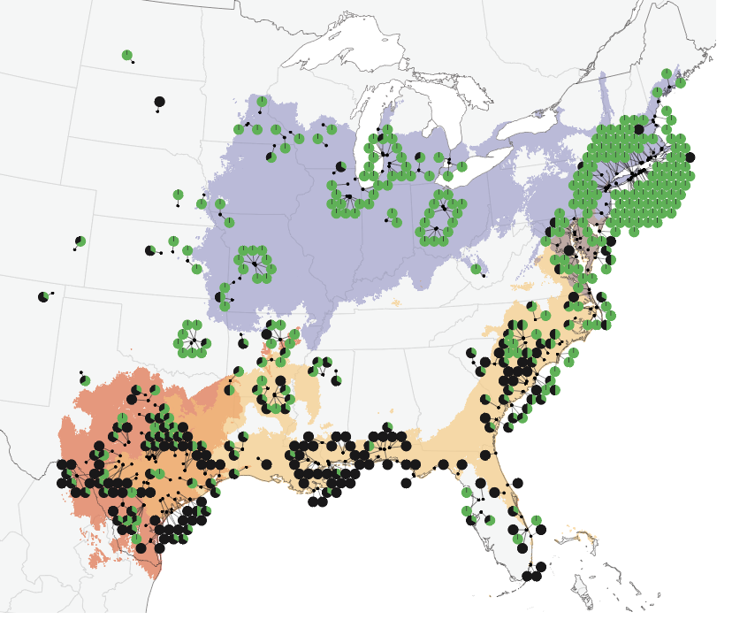
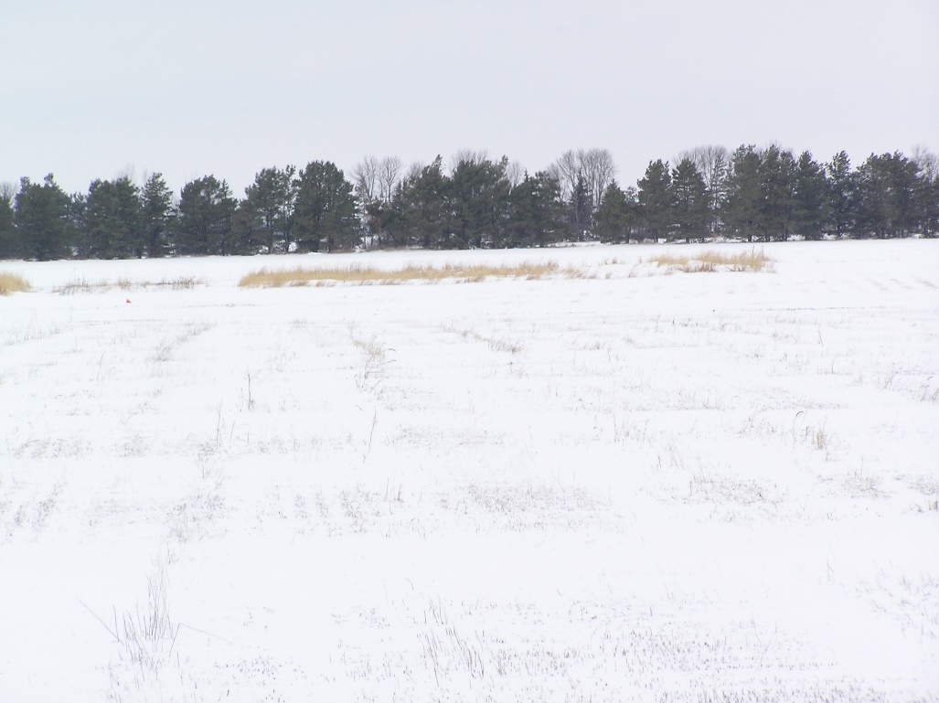
The genetics of GxE in winter survival
Winter 2018 was cold, and we observed considerable winter kill in the north.
Geographic distribution of northern winter kill across germplasm
Brooking SD, 11 degrees F on April 5th
(Lovell et al., in prep)
Notes:
First, I’ll tell you a little bit about the genetics of GxE in winter survival in the northern common gardens. The winter in 2018 was cold, and we observed considerable winter kill in the north, particularly in four of the northern sites. The map on the right here is showing you the distribution of northern winter kill across all genotypes, with each genotype plotted at its location of origin. The green circles are plants that lived at the four northern common garden sites, and the black circles are plants that died. And you can see that most plants from northern locations lived in the northern winter, while many plants from the south died in the northern winter.

Slide 13
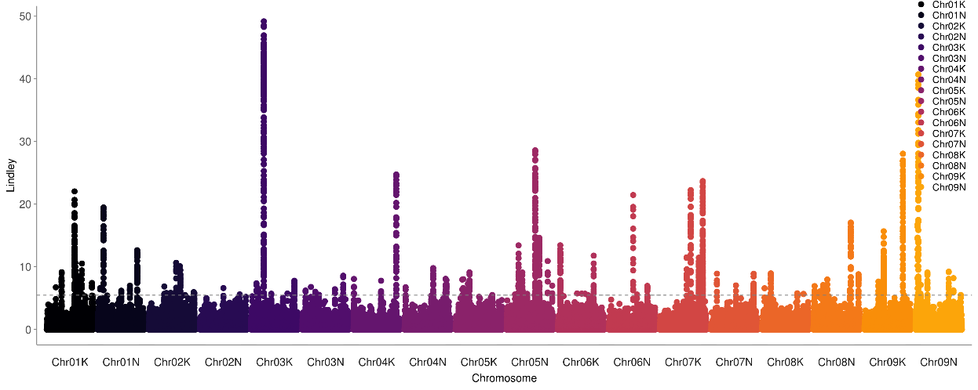
The genetics of GxE in winter survival
Genetic associations for winter survival at four northern sites
Local score approach: Bonhomme et al., 2019 Heredity
Notes:
I did a genome-wide association on winter survival in the north, and applied a local score approach which uses linkage disequilibrium smoothing to prioritize candidates for follow-up. So this is the Manhattan plot for this trait, with significance on the y axis, chromosome on the x axis, and different chromosomes indicated by different colors.

Slide 14
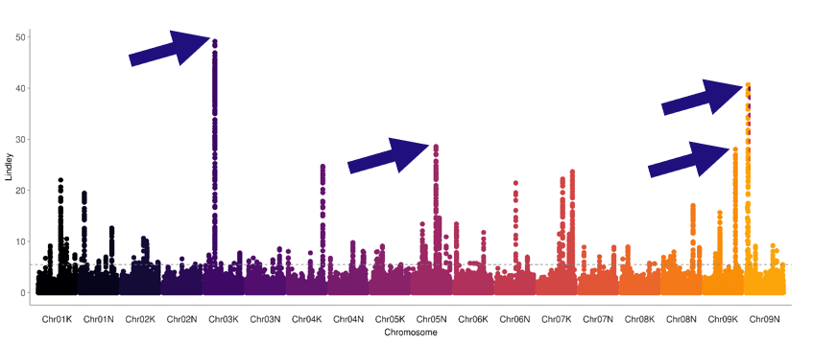
The genetics of GxE in winter survival
Genetic associations for winter survival at four northern sites
Chrom. | Position | Pattern of Allele Frequency | Gene ID | Rice gene annotation
Chr03K | 17.45 Mb | Variable in Texas and Coastal ecotypes | Pavir.3KG320900 (in gene) | MYB family transcription factor, putative, expressed
Chr05N | 44.40 Mb | Variable in Coastal ecotype | Pavir.5NG297500 (in gene) | expressed protein
Chr09K | 58.99 Mb | Variable in Coastal ecotype | Pavir.9KG487700 (in gene) | rhamnose biosynthesis 1 / NAD dependent epimerase protein, expressed
Chr09N | 4.73 Mb | Variable in Texas ecotype | Pavir.9NG075191 (in gene) | aldehyde oxidase, putative, expressed
Notes:
If we look at the top association from the top four peaks, they all actually map to within single genes. Moreover, there are several sensible patterns of allele frequency – one association varies in both the Texas and Coastal lowland ecotypes, while other associations vary either only in the Texas lowland or only in the Coastal lowland ecotypes.

Slide 15
The genetics of GxE in flowering date
Greenup
Flowering
Days between Greenup and Flowering
The relationship between plant greenup date and flowering date varies more at southern sites than at northern sites
Latitude
Notes:
Now, let’s look at a slightly more complicated example – the genetics of genotype by environment interaction in flowering date. And let me just remind you that we’ve observed that the relationship between plant greenup date and plant flowering date varies more at southern sites than at northern sites, and flowering date is also more variable at southern sites. But boy, it would be nice to get a sense of how alleles affect flowering differently at different sites.

Slide 16
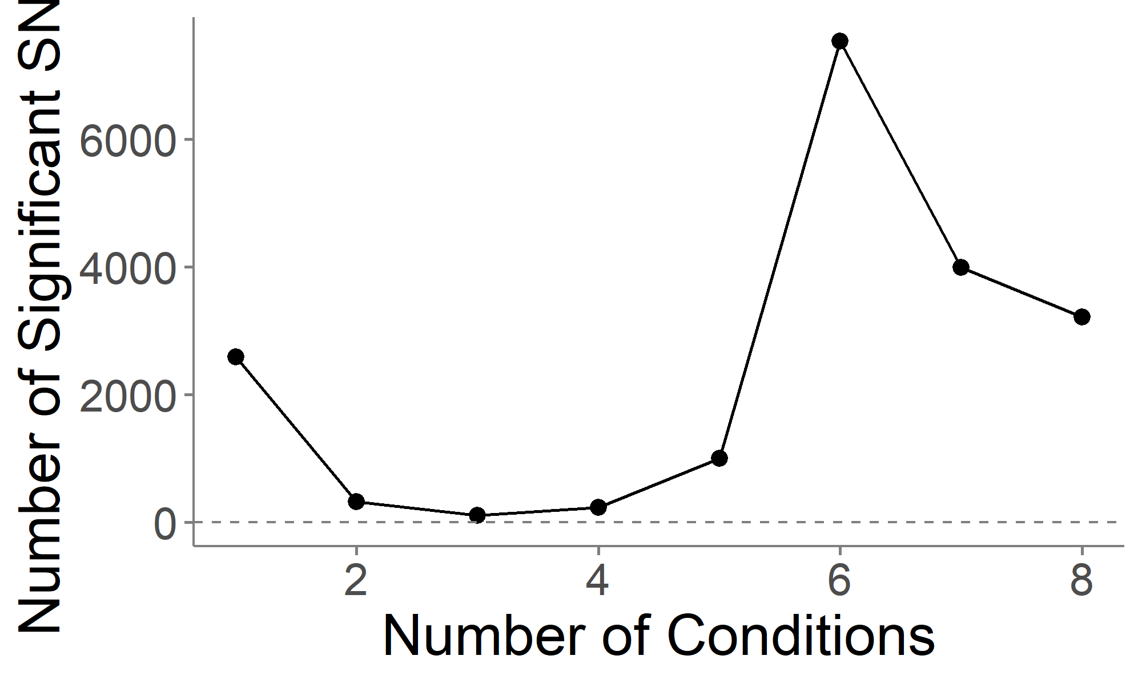
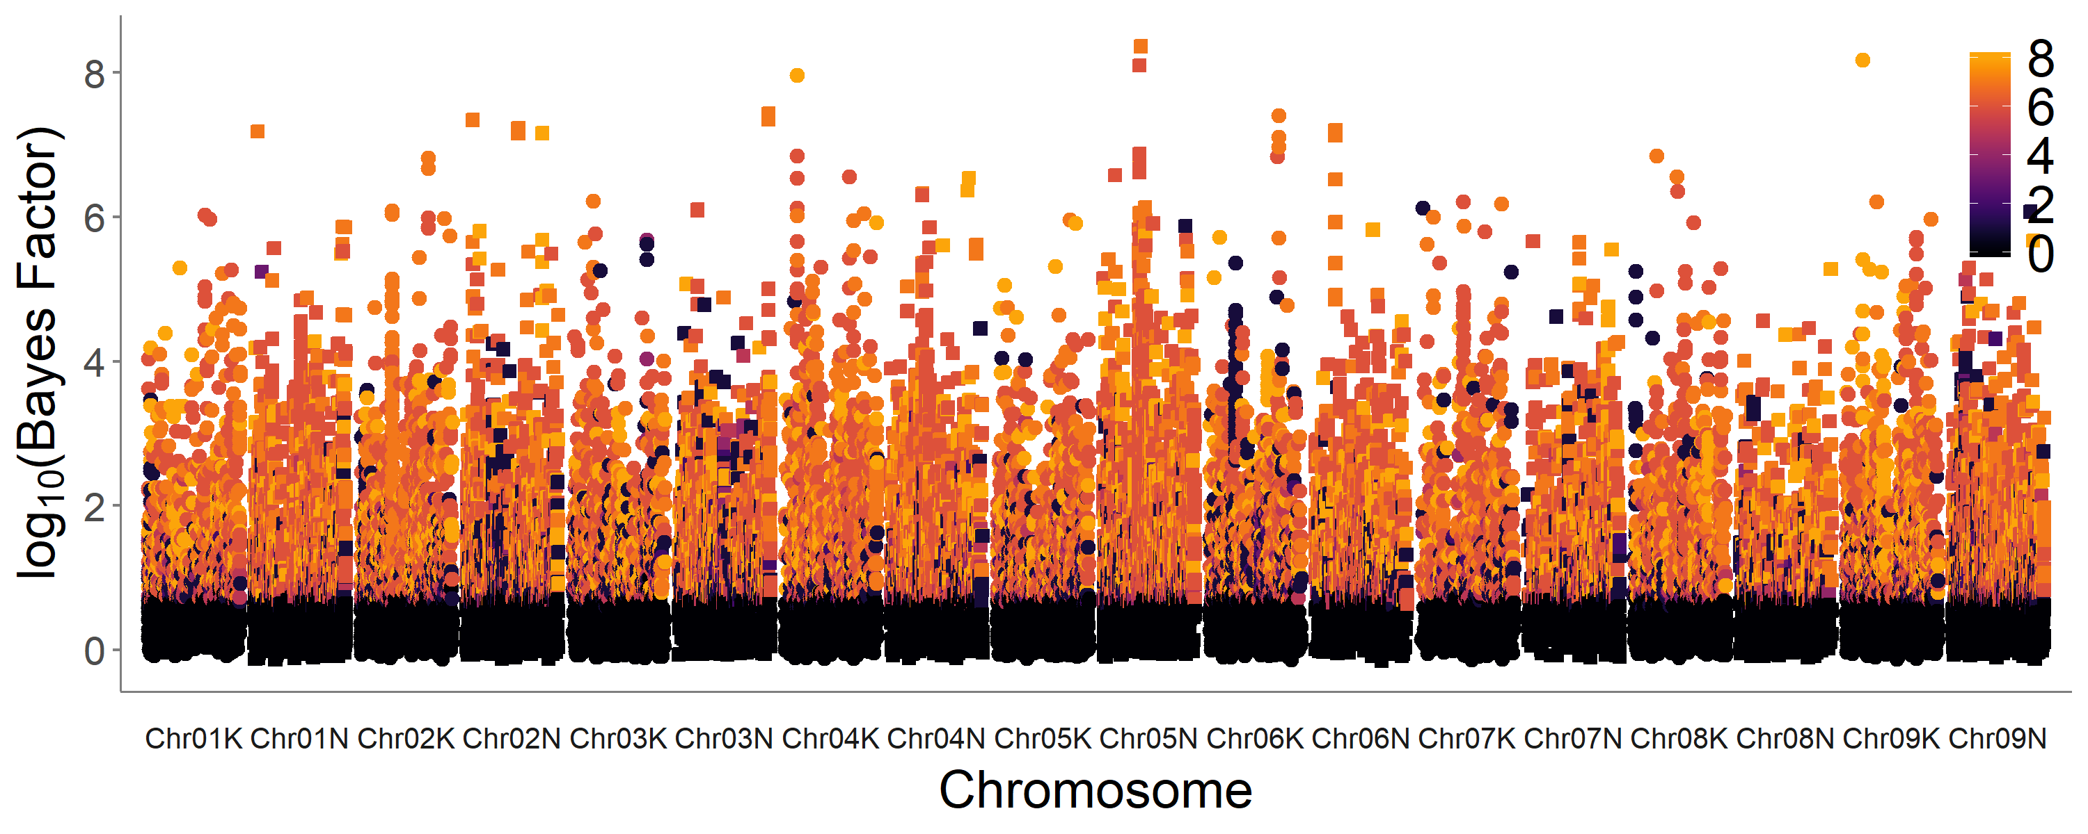
The genetics of GxE in flowering date
“Mashhattan” for Flowering Date
Mash approach: Urbut et al., 2019 Nat. Gen.
Notes:
To do this, we’ve been using a method called mash, or multivariate adaptive shrinkage, which shares information between individual GWAS, or individual estimates of allele effects, to gain power to detect both significant effects and effects that differ by condition, or in our case, by location. I unfortunately don’t have time to get into details of the method right now, but I’d love to answer questions about it, particularly over beers. Regardless, when you use this method, you can get new information, which I am showing you now for flowering date, in a plot I’m calling a “mashhattan”. Here, the y-axis is still significance, but the color is now indicating how many locations that each SNP has a significant effect at. So the more orange the color, the more locations that that SNP affects flowering date at. And if you plot all significant SNPs by the number of sites that they affect, which is the plot at the top right of this slide, you can see that most significant SNPs affect flowering at six or more of the common garden locations.

Slide 17
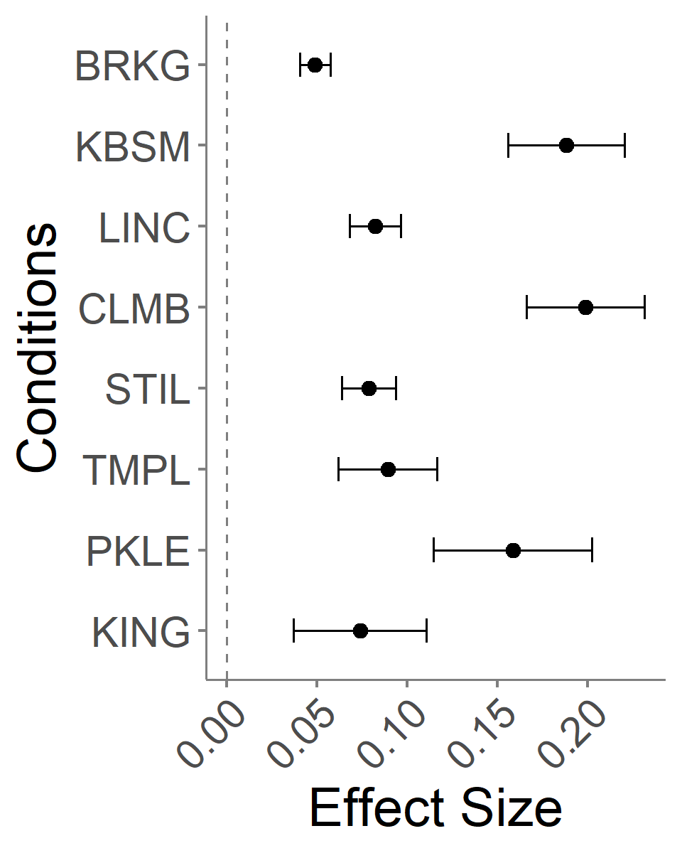
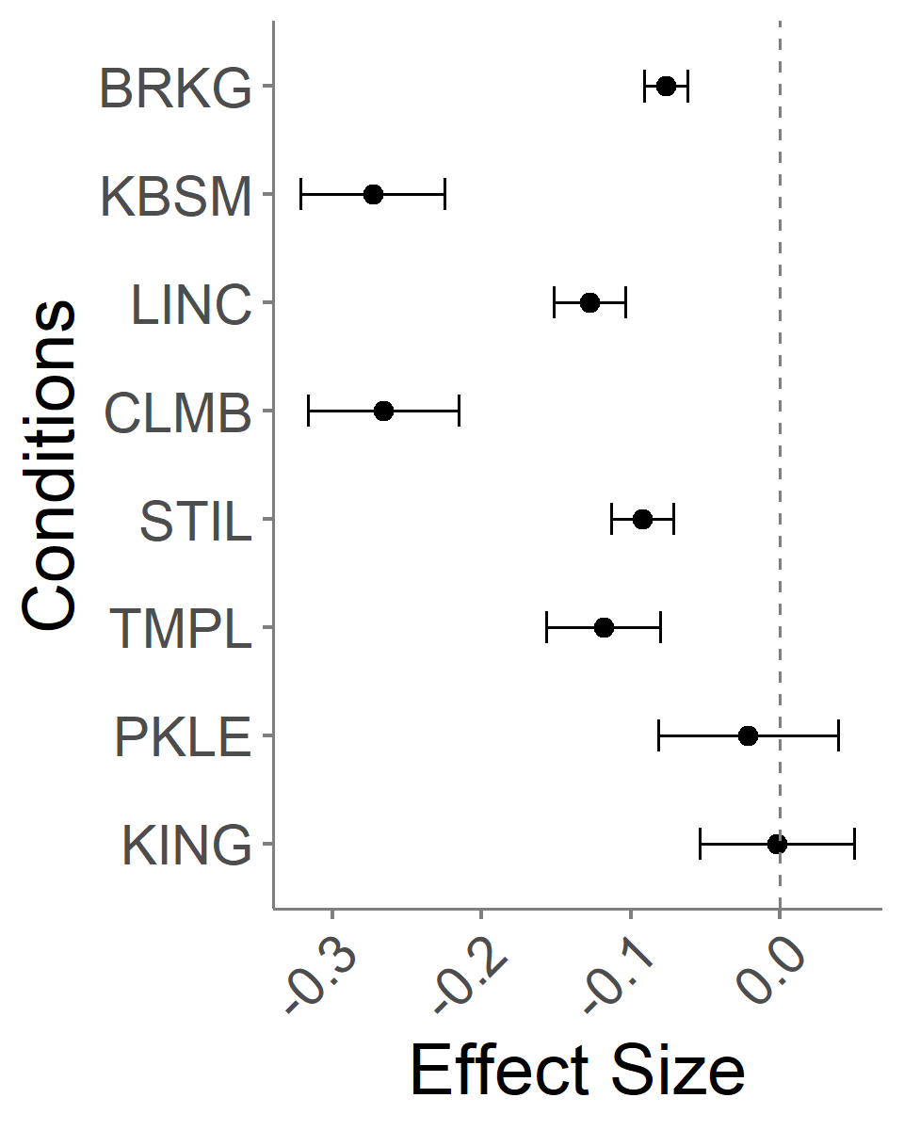
Estimates of effects of single SNPs on flowering date across eight common garden sites.
Chr02N at 57.93 Mb:
Chr05N at 28.31 Mb:
Latitude
Notes:
Mash also allows you to visualize the effect estimates for SNPs at all of the locations, and here I am showing you two examples of that – location is on the y-axis, and the effect size of the SNP is on the x-axis, with the dashed line at zero indicating a SNP with no effect. So we can see that, for one of these SNPs, it affects flowering date at all eight common garden locations, but the magnitude of the effect differs by sites. And for the SNP on the right, we can see that the SNP affects flowering date at six of the sites, but not the two southernmost sites, and it has the largest effect on these sites that are further east. And we can also determine gene annotations near these SNPs.

Slide 18
Summary and Outlook
Widespread G x E underlies strong patterns of local adaptation
Conditional effects are common
In terms of breeding, we may be able to select stable QTL or stack together conditionally beneficial QTL to minimize tradeoffs and improve general vigor and climate adaptation.
There is more to come: The diversity panel and common gardens will expand available genetic variance and opportunities for studying adaptability and GxE
We hope this resource will be useful to the community and welcome collaborative efforts.
Notes:
So, to summarize, we see evidence for widespread GxE that underlies strong patterns of local adaptation in switchgrass. We see many conditional effects, and this gives us hope that for breeding purposes, we may be able to stack alleles with stable effects together, or stack conditionally beneficial alleles to improve plant vigor and climate adaptation. I’ll also mention that there is much more data to come, and that we’d love it if you got involved yourselves – we want this to be a community resource.

Slide 19




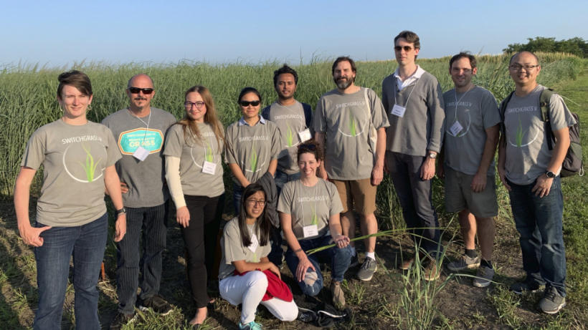
Collaborators
Tom Juenger (UT Austin)
David Lowry (Michigan State University)
Felix Fritschi (Mizzou)
Phil Fay (USDA-ARS, Temple TX)
Jason Bonnette (UT Austin)
Laura Bartley (University of Oklahoma)
John Reilly (USDA-PML, Kingsville TX)
Yanqi Wu (OSU, Stillwater OK)
Monty Rouquette (TAMU-Overton, TX)
Rob Mitchell (USDA-ARS, Lincoln NB)
Arvid Boe (SDSU, Brookings SD)
Kyle Turner
Nathan Pfluger
Matt Donoghue
Chris Bourbois
Jonathan Colen
Sam Lutfy
Marissa Van Damme
Quinn Hiers
Paige Overton
John Row
Joey Budi
Logan Simon
Jeremy Schmutz (JGI/HudsonAlpha)
Jerry Jenkins (HudsonAlpha)
Avinash Sreedasyam (HudsonAlpha)
Sujan Mamidi (HudsonAlpha)
John Lovell (HudsonAlpha)
Shiangqiang Shu (LBL)
Dan Rokhsar (DOE JGI)
Kerrie Barry (DOE JGI)
Funding
DOE Sustainability
JGI CSP
NSF PGRP
DOE Arpa-e
Notes:
big project funded by multiple entities
Kerrie – sample submission
Dan – co-lead at JGI
Shu
Avinash – expression analyses
Jerry – switchgrass annotation

Slide 20
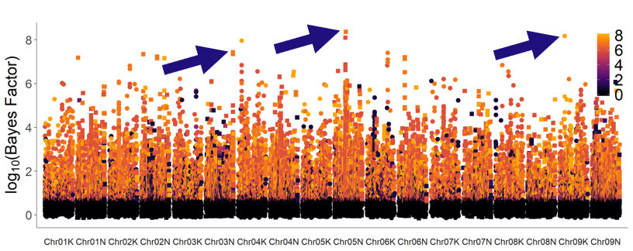
The genetics of GxE in flowering date
Genetic associations for winter survival at four northern sites
Chrom. | Position | Pattern of Allele Effects | Gene ID | Rice gene annotation
Chr03N | 68.10 Mb | Allele effects flowering at 6 northern sites | Pavir.3NG273400 (in promoter) | YABBY domain containing protein, putative, expressed
Chr05N | 29.71 Mb | Allele effects flowering at 6 northern sites | Intergenic
Chr09K | 12.89 Mb | Allele effects flowering date at all sites | Pavir.9K062457 (in gene) | BTBA4 - Bric-a-Brac, Tramtrack, Broad Complex BTB domain with Ankyrin repeat region, expressed
Notes:
Stogios et al. 2005:The BTB domain (also known as the POZ domain) is a versatile protein-protein interaction motif that participates in a wide range of cellular functions, including transcriptional regulation, cytoskeleton dynamics, ion channel assembly and gating, and targeting proteins for ubiquitination. Several BTB domain structures have been experimentally determined, revealing a highly conserved core structure. The BTB domain is typically found as a single copy in proteins that contain only one or two other types of domain, and this defines the BTB-zinc finger (BTB-ZF), BTB-BACK-kelch (BBK), voltage-gated potassium channel T1 (T1-Kv), MATH-BTB, BTB-NPH3 and BTB-BACK-PHR (BBP) families of proteins, among others. BTB-ZF proteins are also known as the POK (POZ and Krüppel zinc finger) proteins. Many members of this large family have been characterized as important transcriptional factors, and several are implicated in development and cancer, most notably BCL6, leukemia/lymphoma related factor (LRF)/Pokemon, PLZF, hypermethylated in cancer (HIC)1 and Myc interacting zinc finger (MIZ)1.
In extant angiosperms, five YABBY subfamilies, FILAMENTOUS FLOWER (FIL or YAB1)/YABBY3 (YAB3 or AFO), CRABS CLAW (CRC), INNER NO OUTER (INO or YAB4), YAB2, and YAB5 [21] are distinguished by conserved functions in the initiation of lamina outgrowth, polarity maintenance, and establishment of the leaf margin [23–25]. Almeida et al. [26] and Morioka et al. [27] have provided evidence for the involvement of the YAB2 and YAB5 genes in the evolutionary diversification of style and filament morphology.

Slide 21
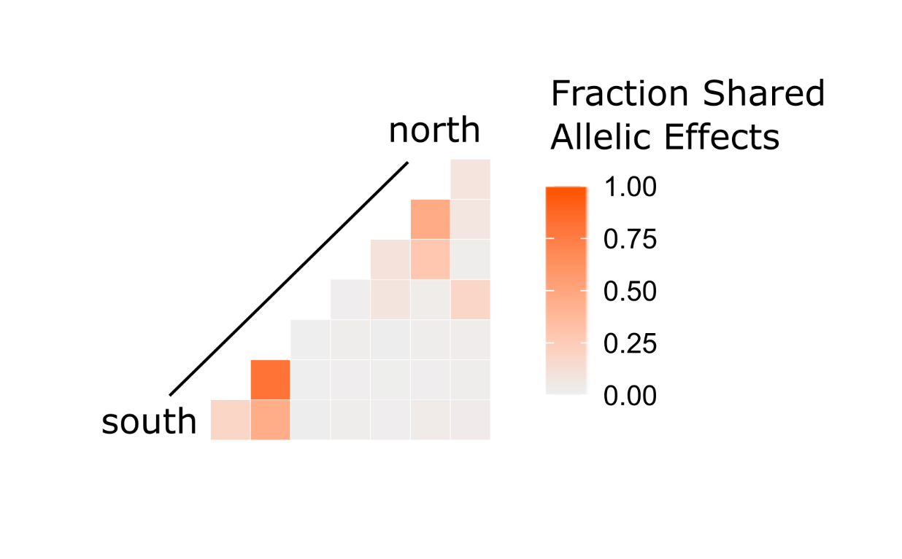
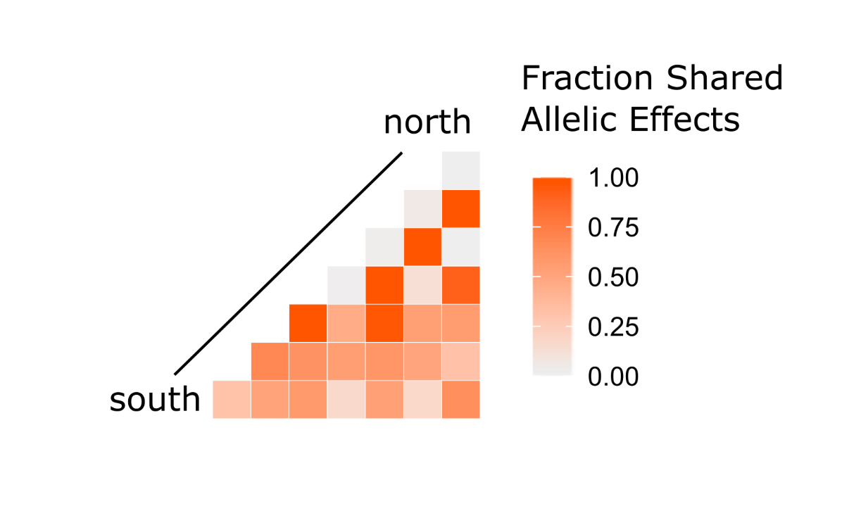
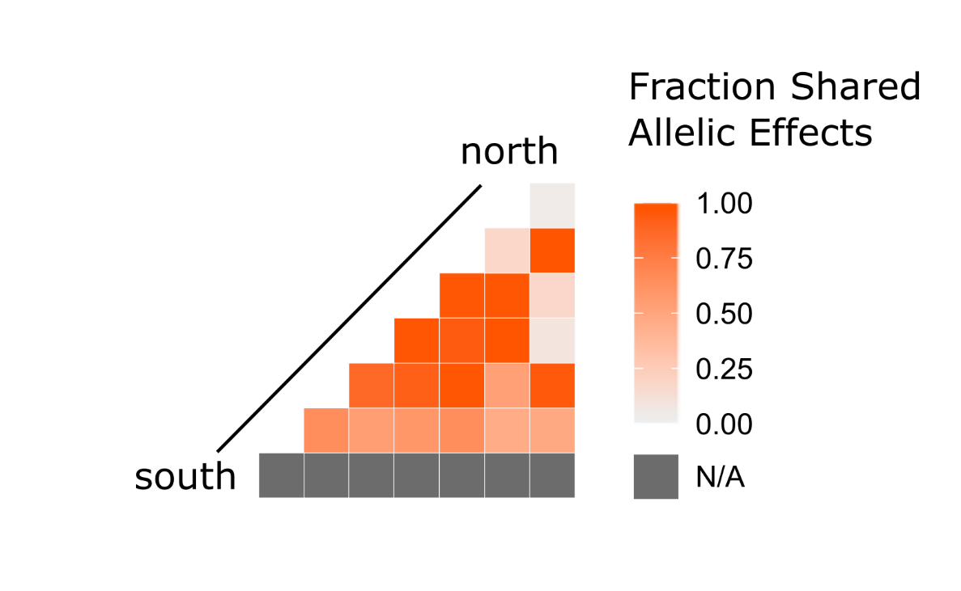
There are similarities in allelic effects on phenology across common garden sites.
Greenup
Flowering
Shared allelic effects on greenup at southern sites
Shared allelic effects on flowering at (western) northern sites
Additional patterns that are unrelated to latitude
Days between Greenup and Flowering

